Slide 1

Lebanese International University
School of Engineering
Department of Engineering .
EENG350L— Electronics Circuit Lab.
Section ID: J.
Report ID: 4
Project Title: Water Level Indicator.
Submitted by: Maya El Chmaitelli
Lab Instructor: Lidia Mehyeddine
Date: Tuesday, May 24, 2022

Slide 2
INTRODUCTION:
The Water Level Detector employs a simple mechanism to detect and indicate the water level in an overhead tank or any other water container .
The circuit not only capable of cautioning a person that the water tank has been filled up to certain level, but also indicates that the water level has fallen below the minimum detectable level.

Slide 3
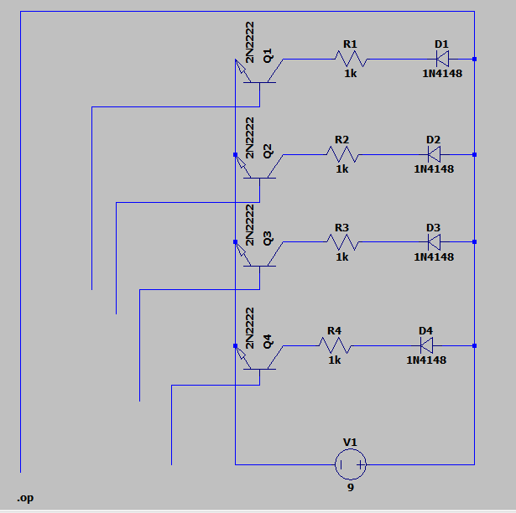
CIRCUIT DESIGN:
The BJT 2N2222 transistor is used in this project as a switch(saturation mode)
When water reaches the BJT transistors' bases on any level, the led on its level lights up which is connected to the Collector.
The emitters are connected to the ground .
The Buzzer Beeps when it reaches the maximum level

Slide 4
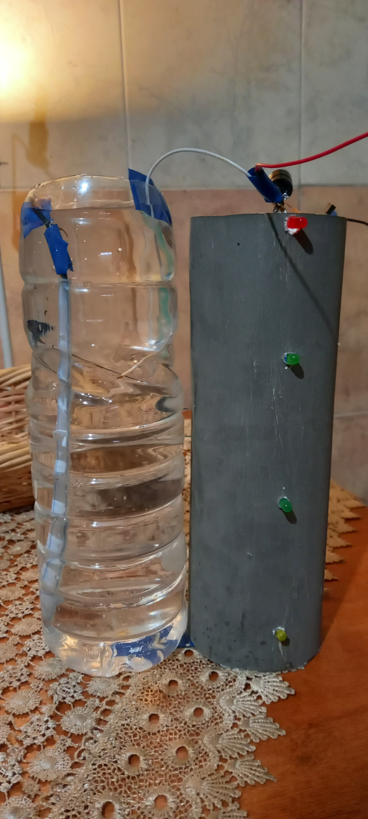

Slide 5
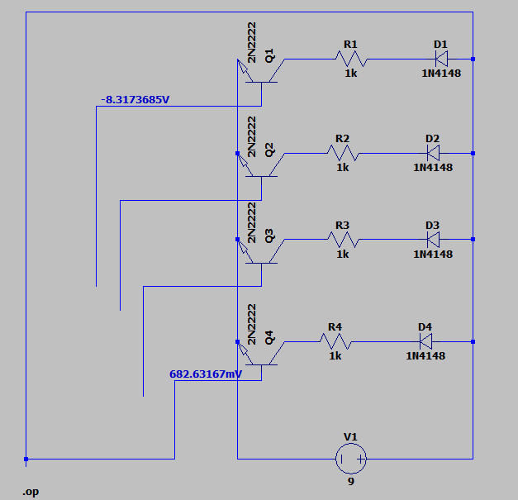
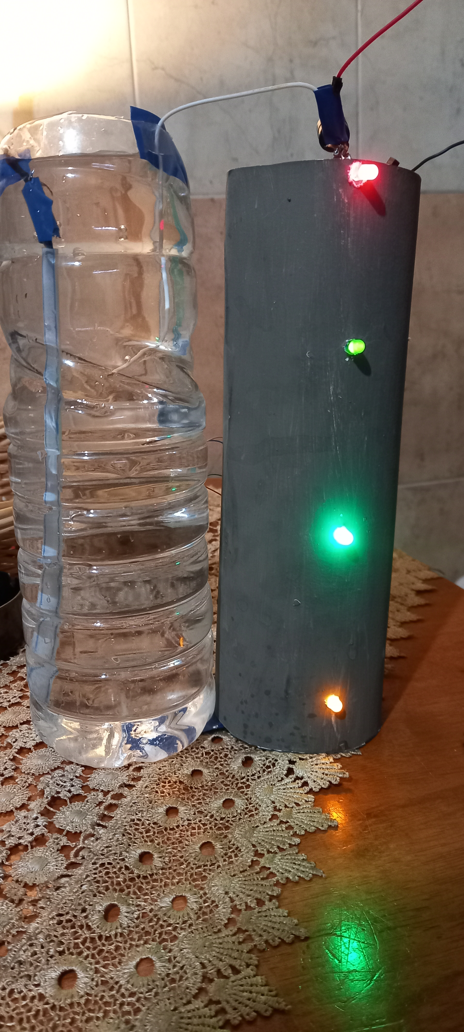
RESULT :
When the base current receives sufficient current, a larger current then flows from the emitter to the collector. The BJT transistor is current controlled
Water reached maximum level, All leds turned on & the buzzer started beeping

Slide 6
Conclusion :
Main Ideas :
The Yellow led turned on when water reached a low level
The red Led turned on and the buzzer started beeping when water hit the maximum capacity of the tank
Advantage:
It has an alarm function
Disadvantage :
Water cannot be stopped automatically
Real life Application :
This circuit is important in appliances such as the water cooler where there is a danger of motor-burnout when there is no water in the radiator used up.

